Slide 1
Module 1
Dr Shweta Mukherjee
VIT Bhopal

Slide 2
Introduction
• Importance of data visualization in scientific & engineering studies
• Role of plotting in understanding data trends
• Applications: research, engineering, business analytics, machine learning

Slide 3
Fundamentals of computations
A programming language generally has following components
1. Data type: Object defined in the program will have some basic characteristic
Example: real or integer.
2. Data structure: Data can be represented in complex form
Example: Arrays.
3. Variables: Place to store the data or values
4. Assignments: It is a statement that sets and/or re-sets the value stored in the variable
Example: a=3+1.

Slide 4
5. Function: It is a command that accomplish a specific task. It generally takes an
argument and return a value
Example: print “hello world” ---> hello world
6. Control structure: Control structures are specific commands that dictate which
part of the program the computer will executed next.
Example: If command

Slide 5
Data
Data is/are a set of values of qualitative or quantitative variables.
Data in itself has a little meaning.
Information
Information is obtained via post-processing of data.
Information has a specific meaning to it.
Information is specific to the requirement.

Slide 6
Qualitative (Categorical) Data
Definition: Non-numerical, describes qualities or categories.
Types:Nominal: Labels without any order.
Examples: Gender (Male/Female), Colors (Red, Blue, Green).
Ordinal: Categories with a meaningful order but no fixed difference.
Examples: Rank in a race (1st, 2nd, 3rd), Education level (High school, Graduate, Postgraduate).
2. Quantitative (Numerical) DataDefinition: Numerical values, measurable.
Types:
Discrete Data: Countable, integers only.
Examples: Number of students in a class, number of cars in parking.
Continuous Data: Can take any real value within a range.
Examples: Temperature, height, weight, voltage, current.

Slide 7
Example of different types of data
For each variable below, identify whether it is ordinal,
categorical, or numeric
Height of a person.(Numeric)
2. Education level (High School, Bachelor’s, Master’s, PhD)(Ordinal).
3. Favorite color (Red, Blue, Green, etc.)(Categorical).
4. Income in rupees per month (Numerical).
In which of these cases we can use histogram? (For Numeric Data)

Slide 8
Data Visualization (2D)
• Line plots, scatter plots, bar charts, histograms
• Use in representing variables vs. time, frequency, or categories
• Example: Temperature variation with time

Slide 9
Data visualization
Plotting
A plot is a graphical technique for representing a data
set, exhibiting the relationship between two or more
variables.
They are an important post processing method.
Data sets can graphically be represented in various
forms
Line chart
Pie chart
Log plot

Slide 10
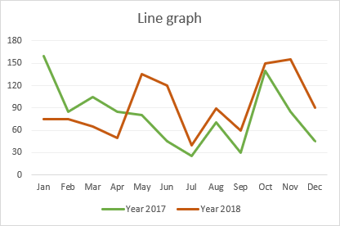
Line chart
Also known as line plot or curve plot or
line graph.
This displays information as a series of
data points called 'markers'.
A line chart is often used to visualize a
trend in data.
A multi-line chart can be used to compare
the behavior of same variables in different
environments or conditions.

Slide 11
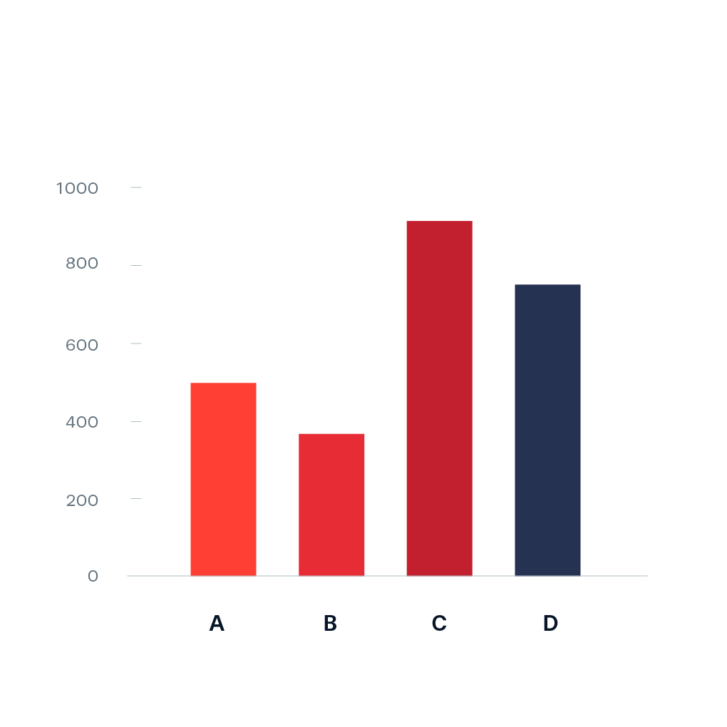
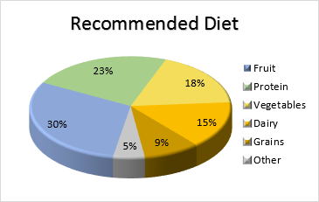
Data visualization
Bar Graphs
Bar graph or bar chart shows the comparison
between the discreet categories.
Pie Chart
It is a circular statistical graph, with each slice
representing the numerical proportion of the
category.

Slide 12
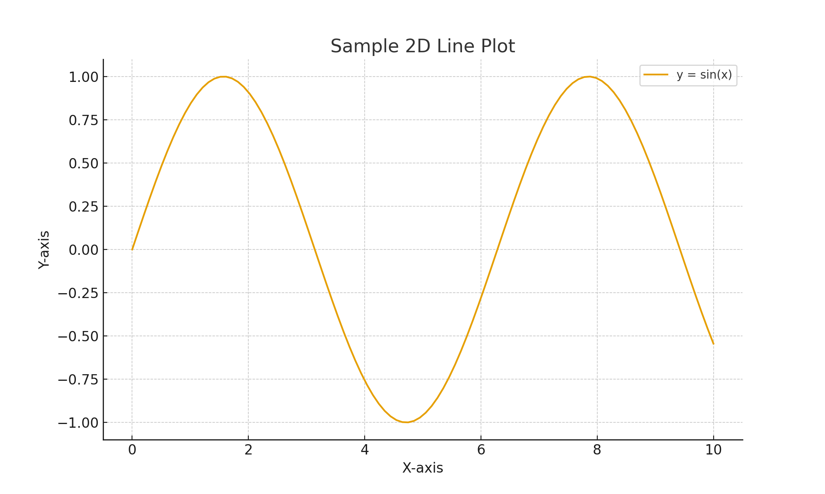

Slide 13
Data plotting - Python
import matplotlib.pyplot as plt
x = [1,2,3,4]
y = [1,2,3,4]
plt.plot(x, y)
plt.show()

Slide 14
Data plotting - Python
import matplotlib.pyplot as plt
x = [1,2,3,4]
y = [1,2,3,4]
plt.plot(x, y)
plt.xlabel('x - axis')
plt.ylabel('y - axis')
plt.show()

Slide 15
Data plotting - Python
import matplotlib.pyplot as plt
x = [1,2,3,4]
y = [1,2,3,4]
plt.plot(x, y)
plt.xlabel('x – axis')
plt.ylabel('y – axis')
plt.title('My first graph')
plt.show()

Slide 16
Data plotting - Python
import matplotlib.pyplot as plt
x = [1,2,3,4]
y = [1,2,3,4]
plt.plot(x, y, color='green', linestyle='dashed', linewidth = 3,
marker='o', markerfacecolor='blue', markersize=12)
plt.xlabel('x – axis')
plt.ylabel('y – axis')
plt.title('My first graph')
plt.show()

Slide 17
import matplotlib.pyplot as plt
Import numpy as np
y1 = [1,2,3,4]
y2 = [1,2,3,4]
tick_label = ['one', 'two', 'three', 'four']
plt.bar(np.arange(len(y1))-0.2,y1,tick_label = tick_label, width=0.4)
plt.bar(np.arange(len(y2))+0.2,y2,tick_label = tick_label, width=0.4)
plt.title('my bar chart')
plt.legend(labels=['a','b'])
plt.show()

Slide 18
import matplotlib.pyplot as plt
ages =[2,5,70,40,30,45,50,45,43,40,44,60,7,13,57,18,90,77,32,21,20,40]
range = (0, 100)
bins = 10
plt.hist(ages, bins, range)
plt.xlabel('age')
plt.ylabel('# of people')
plt.title('My histogram')
plt.show()

Slide 19
import numpy as np
import matplotlib.pyplot as plt
from numpy.polynomial.polynomial import Polynomial
# Sample data
x = np.array([0, 1, 2, 3, 4, 5])
y = np.array([2.1, 2.9, 7.2, 20.1, 50.3, 120.5])
# Fit polynomial of degree 2
coeffs = np.polyfit(x, y, 2) # Quadratic
p = np.poly1d(coeffs)
# Generate smooth curve
x_fit = np.linspace(min(x), max(x), 100)
y_fit = p(x_fit)
# Plot
plt.scatter(x, y, color="red", label="Data Points")
plt.plot(x_fit, y_fit, color="blue", label="Fitted Curve")
plt.legend()
plt.xlabel("X")
plt.ylabel("Y")
plt.title("Polynomial Curve Fitting")
plt.show()

Slide 20
Data Visualization (3D)
• Surface plots, 3D scatter plots, contour plots, wireframe plots
• Used in multi-variable analysis
• Example: Temperature distribution across a surface

Slide 21
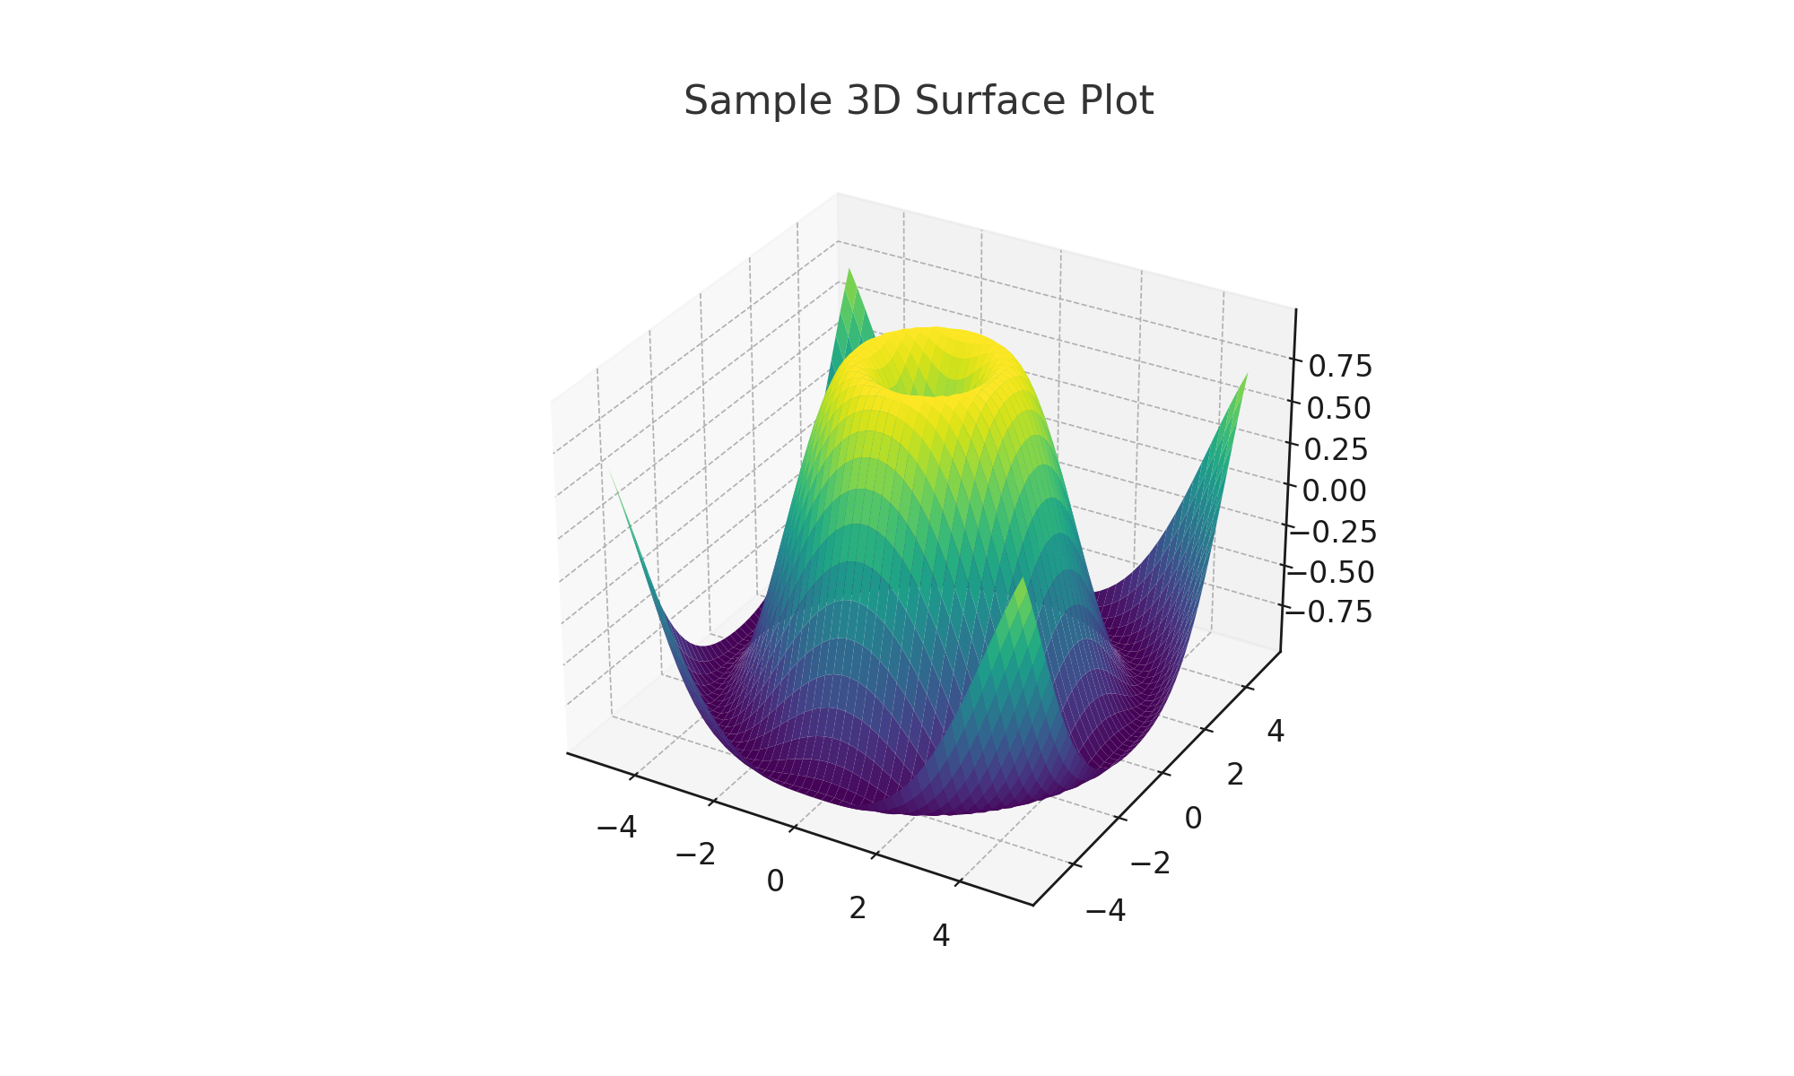

Slide 22
Plotting & Data Interpretation (2D)
• Identify trends: increasing, decreasing, oscillatory
• Relationship between dependent & independent variables
• Outlier detection in data

Slide 23
Plotting & Data Interpretation (3D)
• Understanding patterns in multi-variable datasets
• Peaks, valleys, gradients in 3D surfaces
• Example: Pressure vs Temperature vs Volume (ideal gas law visualization)

Slide 24
Data Interpolation
• Definition: Estimating unknown data points within a known range
• Methods:
- Linear interpolation
- Polynomial interpolation
- Spline interpolation
• Applications: Missing data filling, graphics, engineering

Slide 25
Data Fitting
• Definition: Approximating data using mathematical functions
• Types:
- Linear fitting (y = mx + c)
- Nonlinear fitting (exponential, logarithmic, polynomial)
• Applications: predictive modeling, scientific curve fitting

Slide 26
CURVE FITTING
Curve fitting is a method used to find the mathematical function (curve) that best describes the relationship between a set of given data points. It’s widely used in science, engineering, and data analysis to model real-world phenomena.
🔑 Key Points of Curve Fitting:
Purpose:
To approximate the underlying relationship between variables.
To predict unknown values.
To smooth noisy data.
Types of Curve Fitting:
Linear fitting: Fits data to a straight line (y = ax + b).
Nonlinear fitting: Fits data to a curve (e.g., polynomial, exponential, logarithmic, Gaussian, sine).
Polynomial fitting: Fits data with a polynomial equation
(y = a0 + a1x + a2x² + …).

Slide 27
3. Goodness of Fit:
R² (coefficient of determination): Indicates how well the curve fits the data (closer to 1 = better fit).
Error metrics: RMSE (Root Mean Square Error), MAE (Mean Absolute Error).
4.Methods:
Least Squares Method: Most common, minimizes the sum of squared errors between data points and fitted curve.
2. Optimization methods: Used for nonlinear or complex models.

Slide 28
Types of Curve Fitting
Linear Fit
Polynomial Fit
Exponential Fit
Power Law Fit
Logistic Fit
Gaussian Fit

Slide 29
Linear fitting
What values of ‘a’ and ‘b’ are most appropriate?

Slide 32
Linear Fit (Straight Line)Model:𝑦=𝑎+𝑏𝑥
Example:Data:
𝑥=[1,2,3,4,5]
𝑦=[2.2,2.8,3.6,4.5,5.1]
Best-fit line (least squares):
𝑦=1.1+0.8𝑥
2. Polynomial Fit
Model:
y=a0+a1x+a2x2+⋯+anxn
Example: Data of projectile motion can be fitted with a quadratic polynomial:
y=12.5+8.3x−4.9x2
3.Exponential Fit Example
Model: y=aebxy = ae^{bx}y=aebx
Example: Radioactive decay
Equation: N(t)=N0e−λtN(t) =
Applications: Population decay, chemical reactions

Slide 37
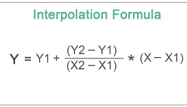
Interpolation is a mathematical method of estimating unknown values of a function for points lying within the range of known data points.
If we know values of a function f(x) at some discrete points, interpolation helps us estimate f(x) at other intermediate points.

Slide 38
Interpolation vs Fitting
Interpolation
• Passes through all data points
• Zero error at known points
• Used for missing data recovery
Fitting
• Best approximation (not all points)
• May have residual errors
• Used for trend modeling

Slide 39
Tools for Visualization & Fitting
• Python: Matplotlib, NumPy, SciPy, Plotly
• MATLAB: plot(), surf(), polyfit()
• Excel: charts, trendlines
• Other software: R, Origin, Tableau

Slide 40
Case Study Example
• Dataset: Experimental data of stress vs strain
• Visualization: 2D stress-strain curve
• Fitting: Linear (Young’s modulus) or nonlinear (plastic region)
• Interpolation: Missing stress values at intermediate strains

Slide 41
Conclusion
• Data visualization simplifies complex data
• 2D & 3D plots help in pattern recognition
• Interpolation → missing data estimation
• Fitting → modeling and prediction
• Essential skills in data science & engineering

Slide 42
References / Q&A
Books:
• Data Visualization: A Practical Introduction – Kieran Healy
• Numerical Methods for Engineers – Chapra & Canale
Tools: Python (Matplotlib, SciPy), MATLAB

